Slide 1
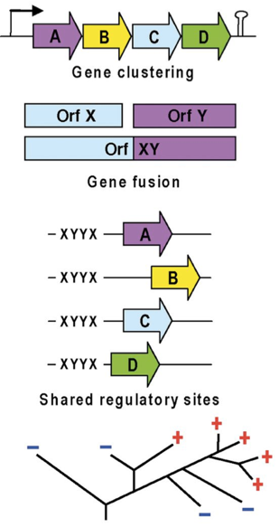
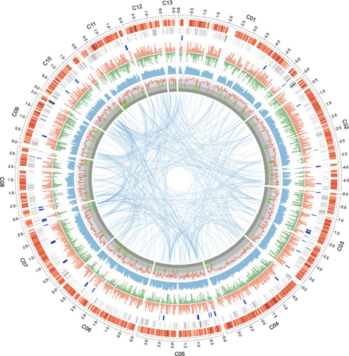
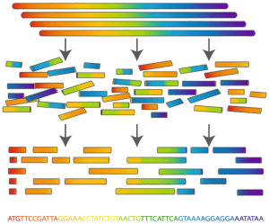
‘Sequence a Genome’ (SAGE)
Master Molecular Life Sciences
Philipp Engel
Department of Fundamental Microbiology, UNIL
Assembly
Annotation
Analysis

Slide 2
Let’s review SAGE I!

Slide 3

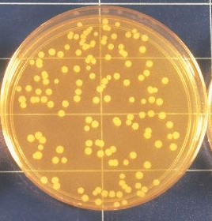
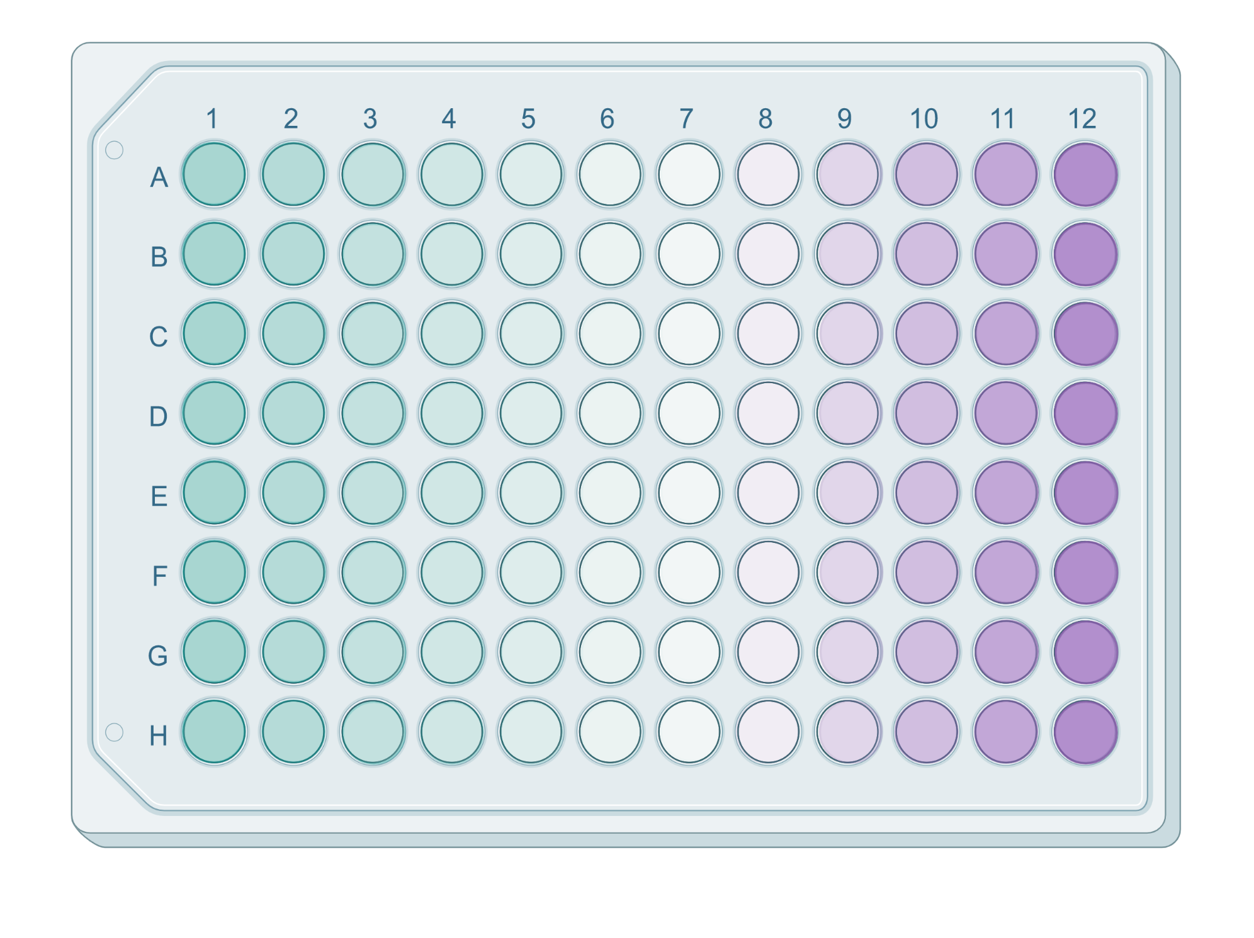
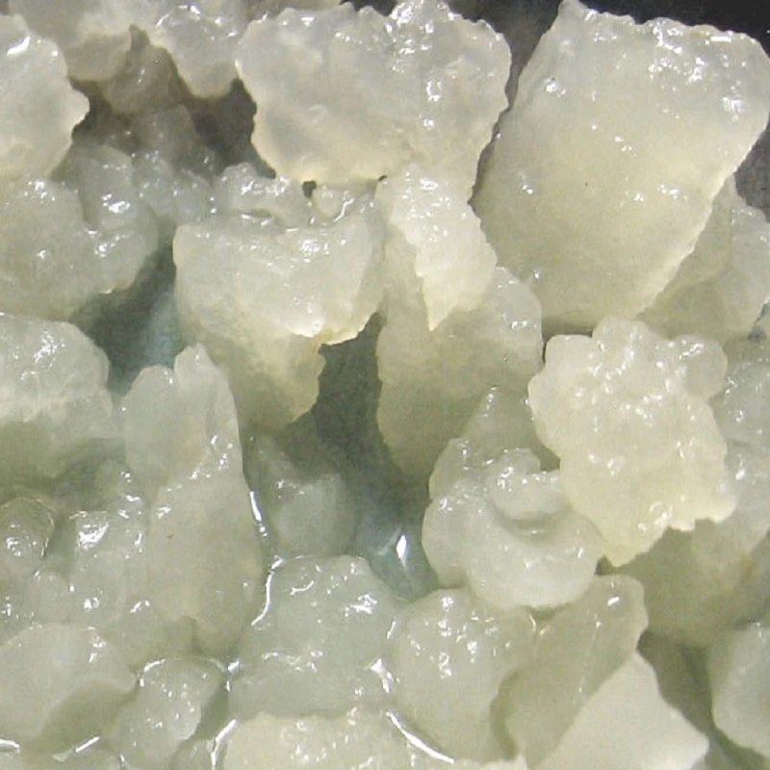
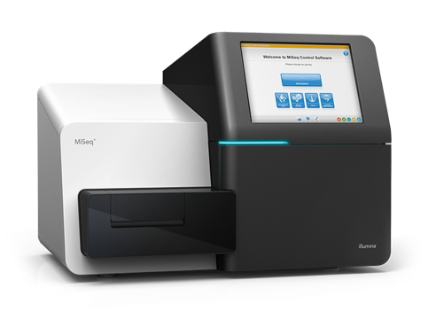
Our starting point
Lectures:
Research questions
Water kefir /fermented food
Sequencing technologies
Paired-end sequencing
Illumina MiSeq
2x250 bp
Your starting point! →
SampleX_L001_R1_001.fastq.gz
SampleX _L001_R2_001.fastq.gz

Slide 4
Illumina genome assembly: steps
Genome assembly = reconstructing the genome from short sequence reads
Paired-end Illumina reads
FastQC: Assess quality
Paired-end Illumina reads
trimmomatic: trim and filter reads
FastQC: assess quality
High quality paired-end Illumina reads
SPAdes: De Bruijn graph assembly
Illumina raw assembly
R: Contig stats and filtering
Lectures:
Genome assembly
Final assembly
bwa and R: read mapping and visualization
Final assembly

Slide 5
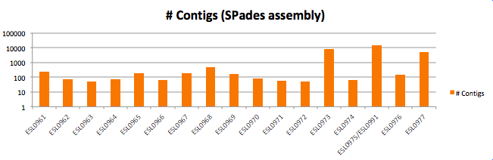
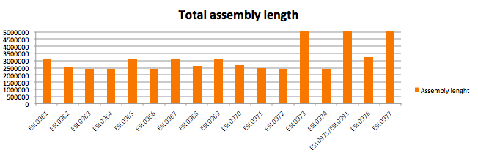

Illumina genome assembly: some results
filtering contigs
(Mb)
Genome length: 2.4Mb – 18Mb
Number of contigs: 53-15123

Slide 6
Illumina genome assembly: what’s next?
Our Illumina genome assembly = Draft genome
Draft genome → several contigs with gaps in-between
Complete genome → one contig (or several contigs) without gaps
Option 1:
Option 2:
Illumina draft genomes
Nanopore/PacBio sequencing
Published genomes:
286’625 genomes
Complete genomes:
20’714
Genome annotation
Complete genome
Genome annotation
Genome analysis
https://www.ncbi.nlm.nih.gov/genome/browse#!/prokaryotes/
Genome analysis
Publication
Publication

Slide 7
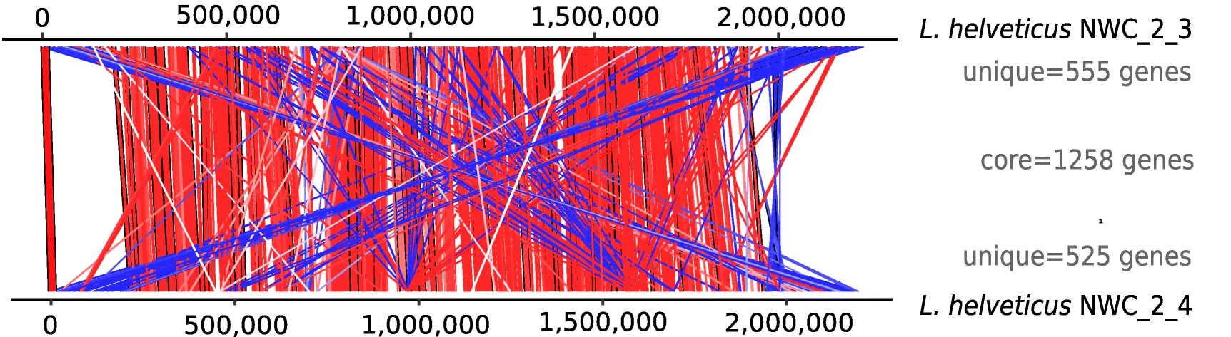
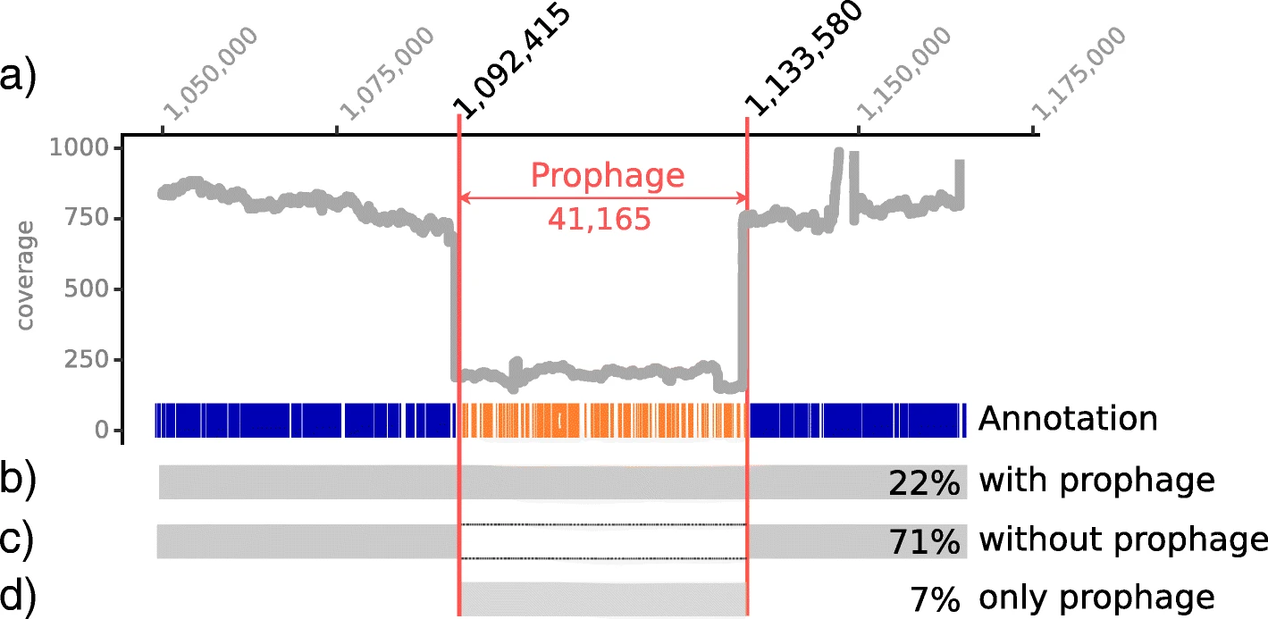
The disadvantage of incomplete genomes
Genes missing due to location in contig gaps
Copy number of repeated genes unknown (over/under-estimation of genes)
Order of genes and genome regions unknown
Genomic context of features unknown
Incomplete genomes are not included in certain reference databases
Genomic context
Genome synteny

Slide 8
Nanopore (ONT) assembly
Lectures:
ONT sequencing
ONT sequencing reads
awk & R: Check quality → length distribution
ONT sequencing reads
filtlong: filter longest reads; & 50-150x coverage
awk and R: Check quality → length distribution
Filtered ONT reads
flye: Overlap-Layout-Concensus (OLC) assembly
Raw ONT assembly
minimap/racon + bowtie2/Pilon: correct sequencing errors
Polished ONT assembly
CheckM and DRAM
Confirmed high quality assembly/complete genome

Slide 9
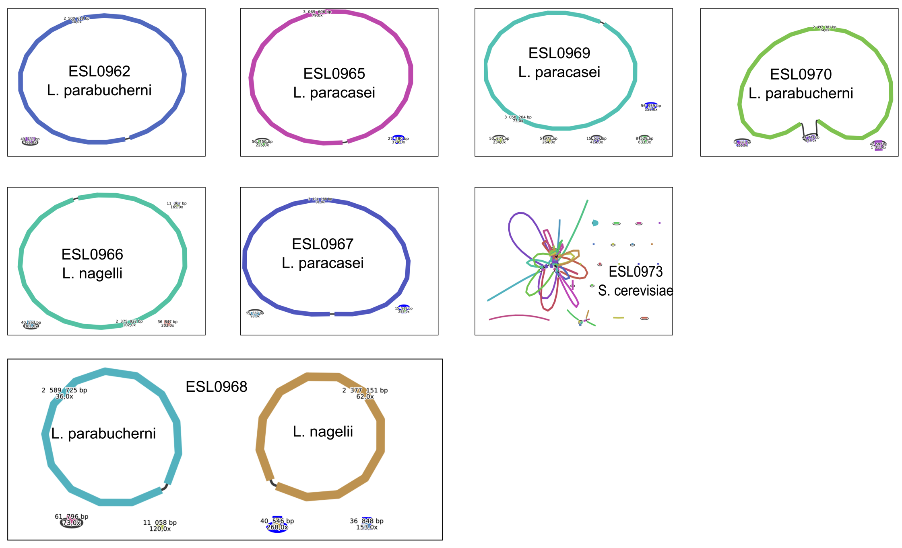
Many genomes are COMPLETE
17 genomes in total:
14 circular chromosomes
3 incomplete genomes

Slide 10
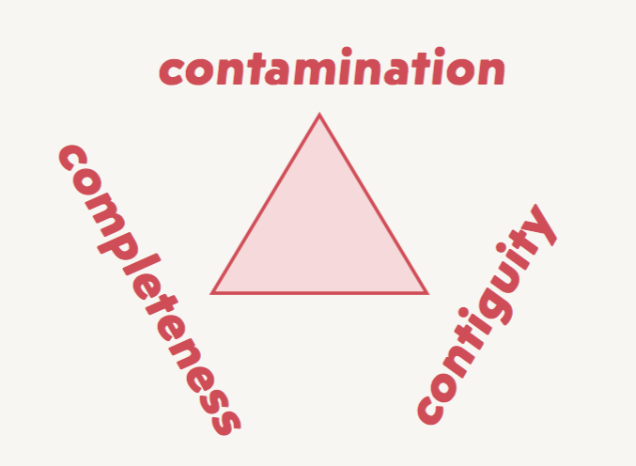

Complete genome = good genome?
Lectures:
Genome annotation
All essential genes present?
Single copies of essential genes?

Slide 11
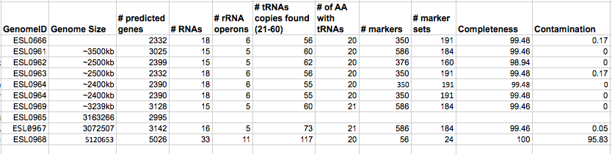
CheckM checks several quality factors
This can be reported with the publication to demonstrate that we have high quality complete genomes

Slide 12
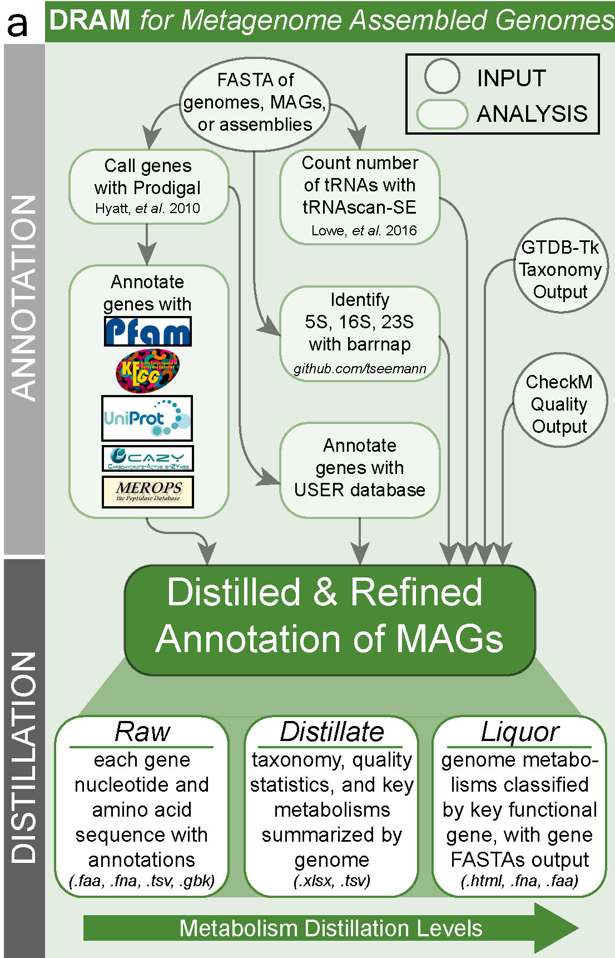
Functional annotation of genomes: DRAM
Genome sequence
Structural annotation
Genome features (ORFs, genes, CDS)
Functional annotation
Functional description of features
Idea of functional annotation:
no experiments
but based on homology
if similar to gene with described function, then same function
Comparison: genome vs database of functions

Slide 13
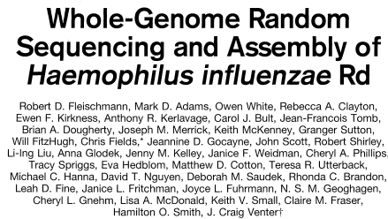
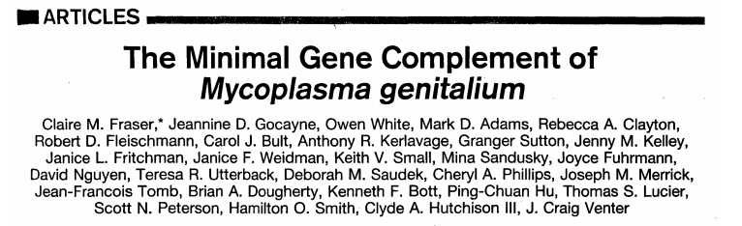
Put genomes into context (=Comparative genomics)
1st genome paper: Science 1995
Pathogen
Upper respiratory tract
Extracellular, host-associated
Meningitis, Bacteremia, Pneumonia
Genome size: 1.83 Mb
Comparative
genomics
2nd genome paper: Science 1995
Pathogen
Urinary/genital tract
Intra/extracellular, host-associated
Urethritis, pelvic inflammations
Genome size: 0.58 Mb

Slide 14
Put genomes into context!
Which genomes to compare?
1. Compare bacteria isolated from same environment
2. Compare to closely related bacteria isolated from other environments
→ Depends on your research question!

Slide 15
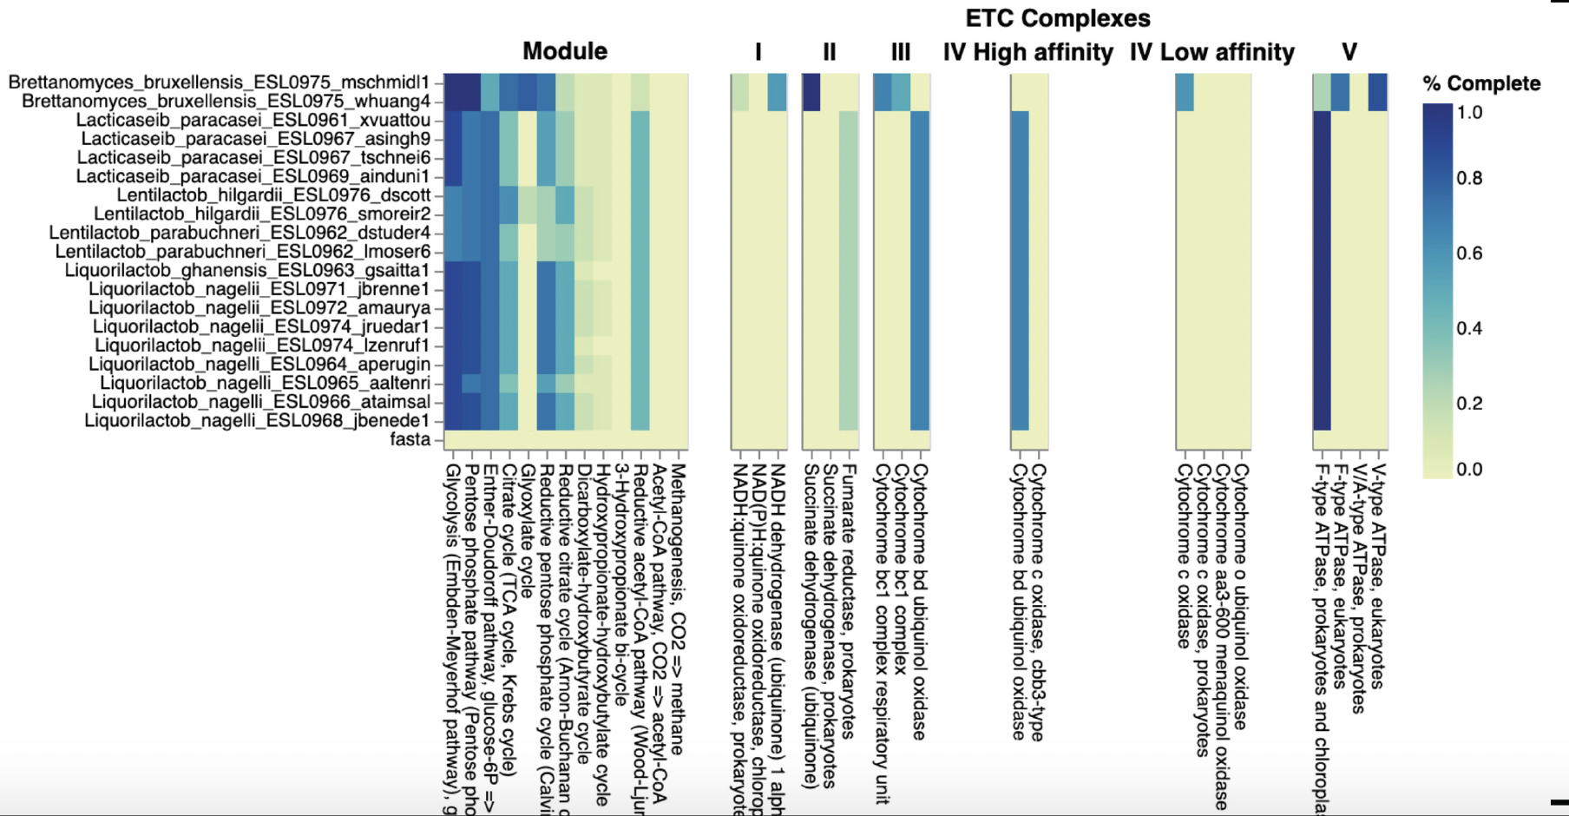
Compare bacteria isolated from same environment

Slide 16
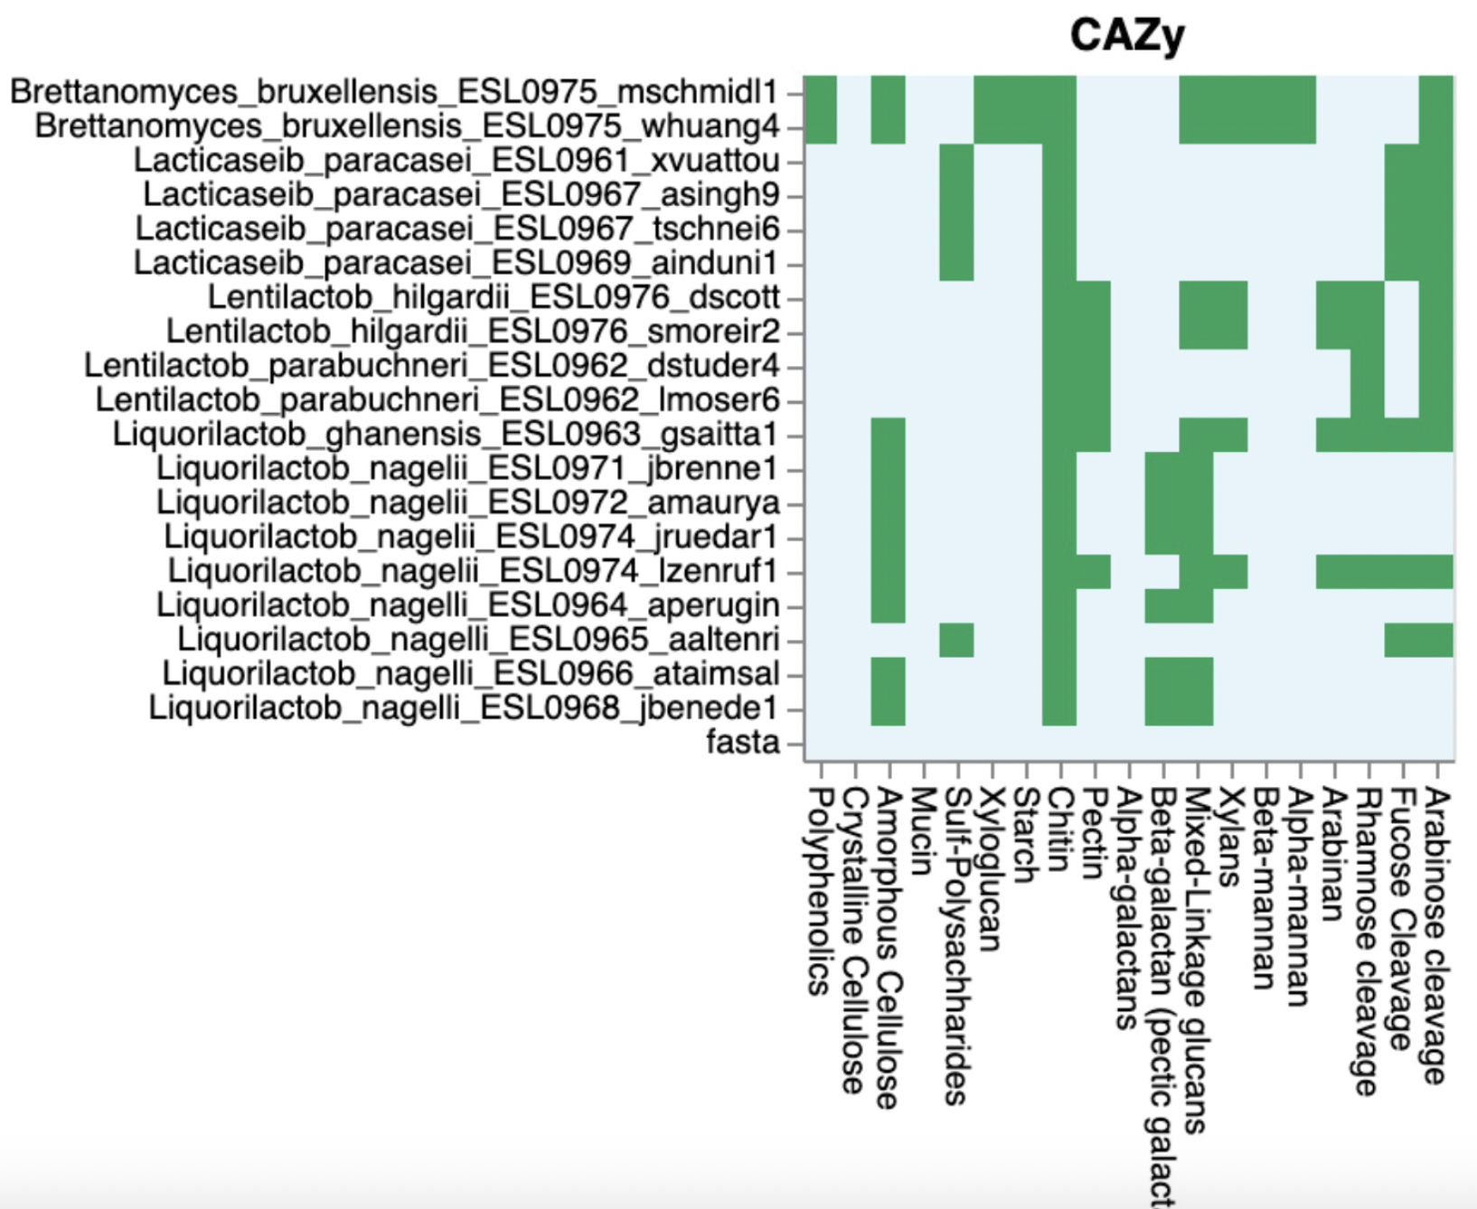
Compare bacteria isolated from same environment
Different water kefir isolates have different capabilities for sugar breakdown and utilization.
Niche partitioning?
Coexistence?

Slide 17
Compare genomes to closely related bacteria
Which are the next closely related bacteria?
What is their phylogenetic relationships?
How many/Which genes do they share?
Are water kefir bacteria evolutionary distant from bacteria isolated from other environments (other food, animal hosts)?
Do water kefir bacteria possess specific gene sets needed to grow in water kefir environment?

Slide 18
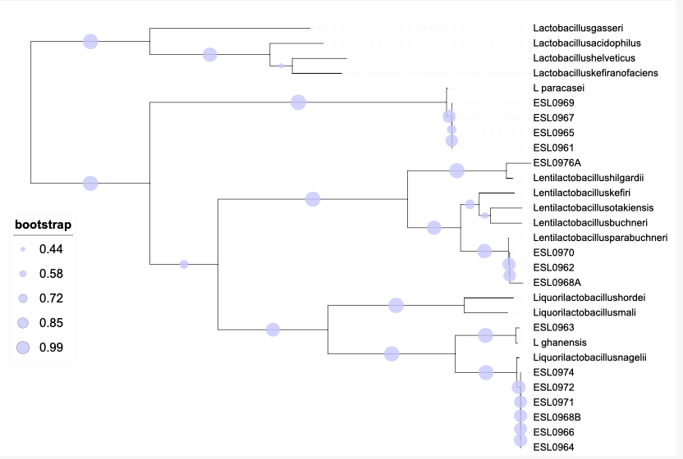
Phylogenetic relationships of our isolates
Genomes of five different Lactobacillus species
→ All coexisting in kefir?
→ No other bacteria in kefir?

Slide 19

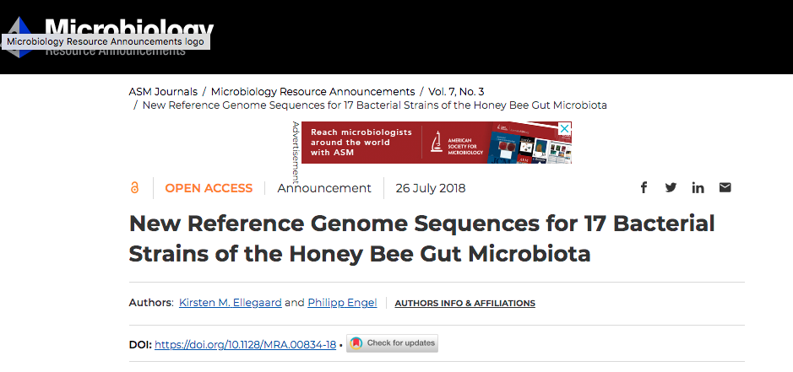
Course concept – Sequencing bacteria!
7th semester
(autumn)
Sequence isolate genomes
Illumina/ONT sequence reads
Genome assembly
Assembly analysis
Genome annotation
We have enough data to write a paper!

Slide 20
Course concept – Sequencing bacteria!
7th semester
(autumn)
Sequence isolate genomes
Illumina/ONT sequence reads
Genome assembly
Assembly analysis
Genome annotation
Comparative genomics
Community-wide analysis
1. What are the functional capabilities of the sequenced bacteria?
2. What is different between Kefir and non-Kefir associated Lactobacilli?
3. Differences between different Kefir-associated lactobacilli?
1. How abundant are the sequenced strains in kefir?
2. How many other strains are present in kefir
3. Is the kefir community stable over time

Slide 21
Course concept – Sequencing bacteria!
7th semester
(autumn)
Sequence isolate genomes
Illumina/ONT sequence reads
Genome assembly
Assembly analysis
Genome annotation
8th semester
(autumn)
Community-wide analysis
Community
changes over time
Functional
gene content
16S rRNA
sequencing
Shotgun
metagenomics
Training-through-research!

Slide 22
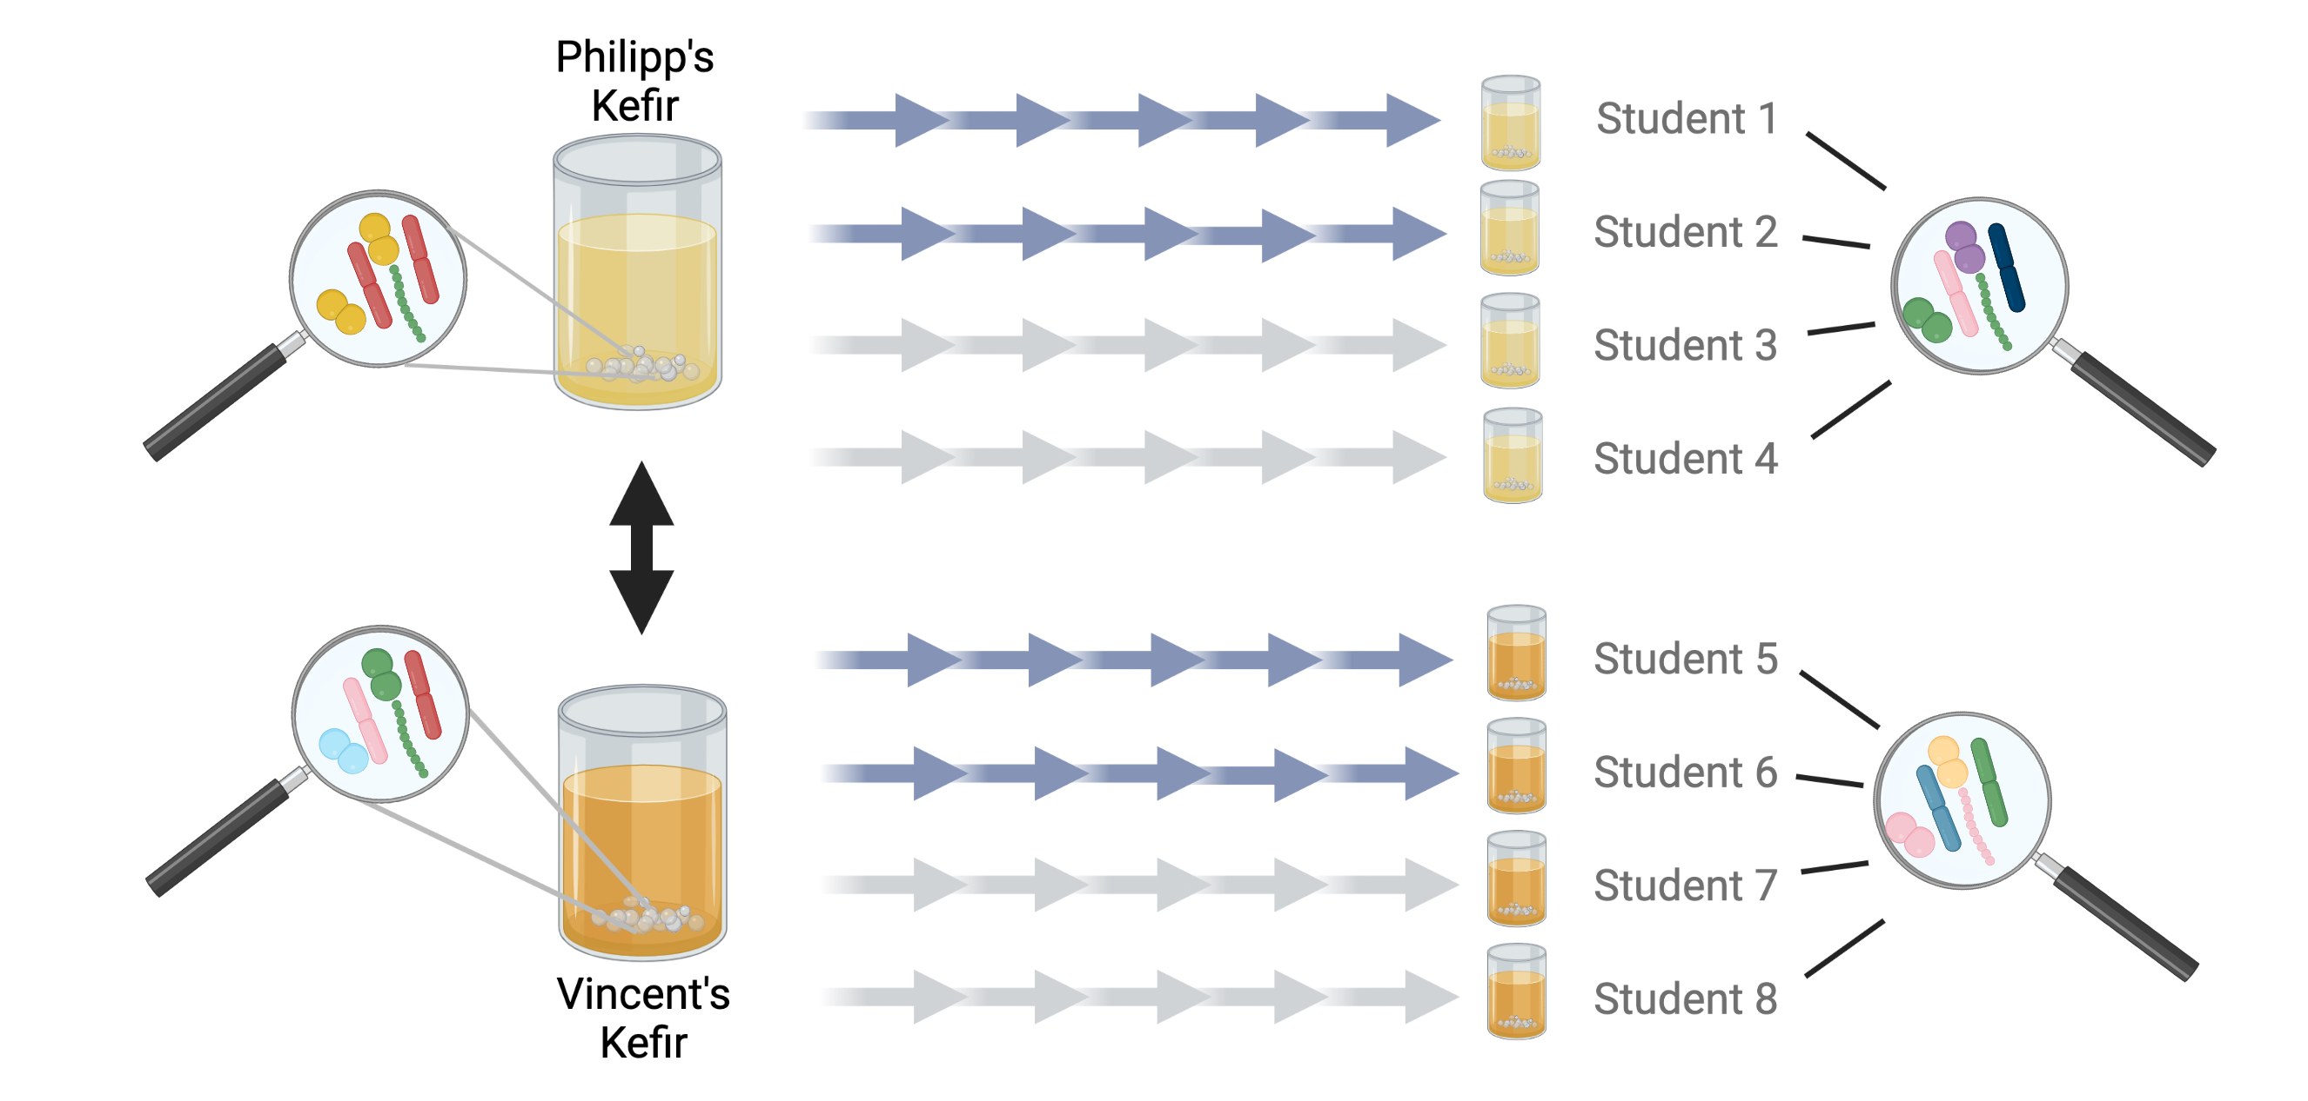
SAGE 2: Research project on Water kefir
The microbiota of animals
Dried figs
Raisins
Question 1
Dried figs
Raisins

Slide 23


Objectives of this course (7th semester)
To learn theoretical aspects of (bacterial) genomics:
What are state-of-the-art sequencing technologies?
How is the quality of sequencing reads assessed?
How are genomes assembled?
How are genomes annotated?
What are general genomic characteristics
What are homologs, paralogs, orthologs?

Slide 24
Objectives of this course (7th semester)
2. To acquire relevant technical skills in bioinformatics and genomics:
LINUX, command-line usage, R, (R markdown)
Handling ‘large’ datasets
Working on a ‘High-performance computing (HPC) cluster’
Processing of next-gen sequencing data
Performing read mappings
Analyzing genome assemblies and annotations
Documentation of bioinformatic analyses

Slide 25
Exam: what we expect you to know
Being able to recapitulate what we did
Theory behind sequencing, assembly, quality check, and annotation
Pros and cons of different approaches (Illumina vs Nanopore)
Major problems: why and how to solve them?
Why did we do each analysis?
Rough idea of the results we obtained
Biological context
No coding needed/ No questions about bash/R commands
How to prepare:
Go through lectures, tutorials, and recap presentations
Make sure you have understood the different steps of the tutorials

Slide 26
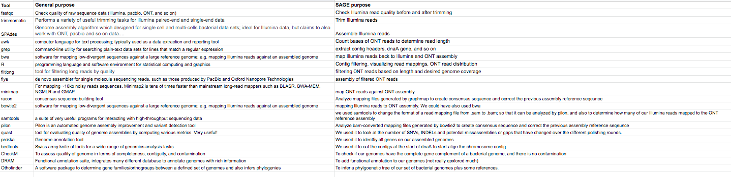
List of software we used
→ Look at google spreadsheet for complete list

Slide 27
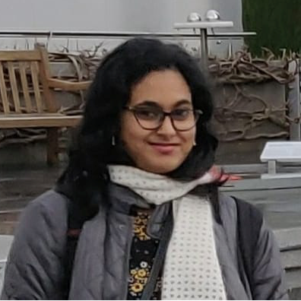
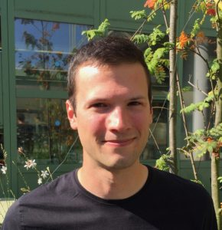
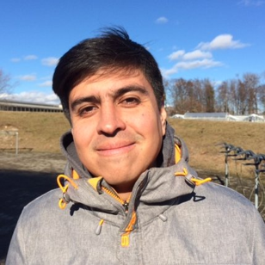

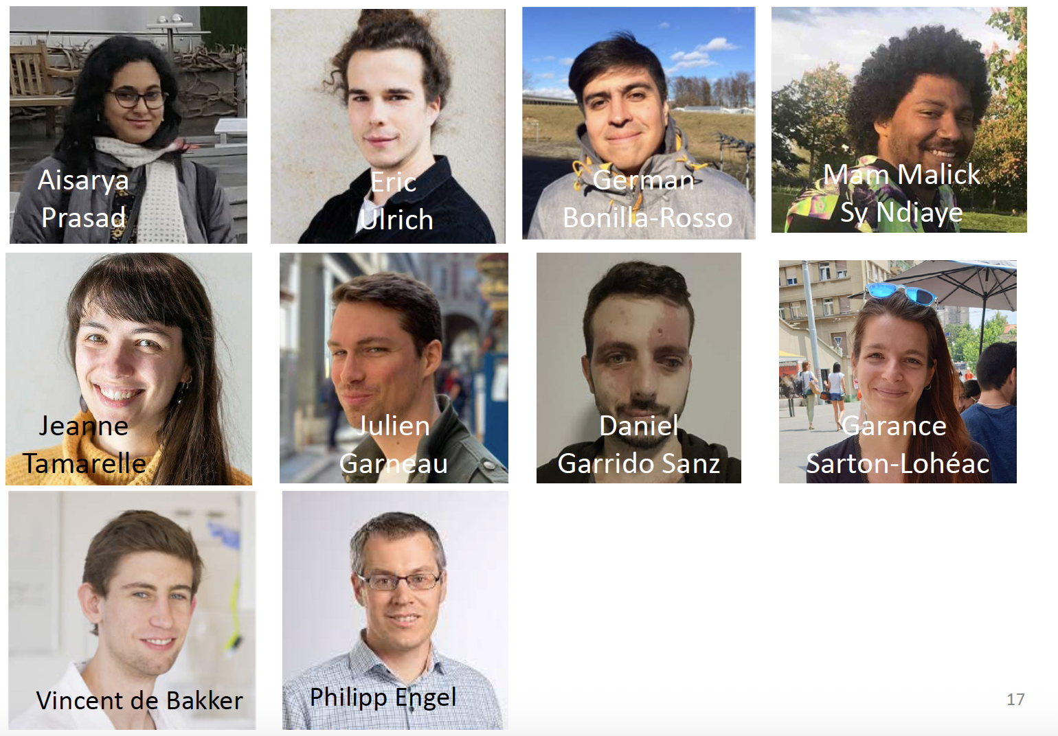
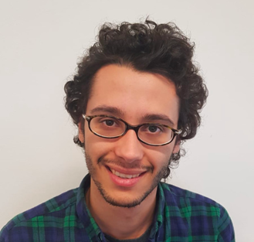

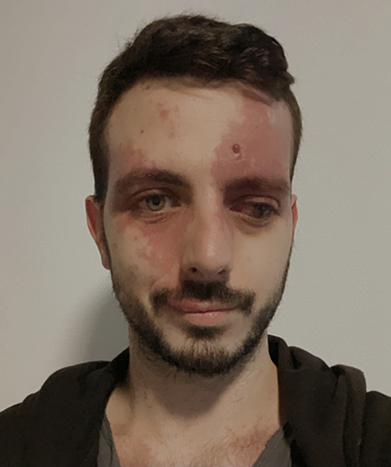
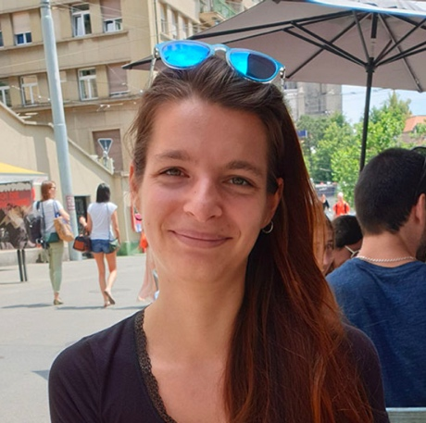

Thank you Assistants!
Aiswarya
Prasad
Gilles Baud
German
Bonilla-Rosso
Mam Malick
Sy Ndiaye
Olivier Emery
Vincent
Somerville
Daniel
Garrido Sanz
Garance
Sarton-Lohéac
Yassine El Chazli
Vincent de Bakker

Slide 28
Thank you Students!

Slide 29
Questions?

